Slide 1
Sentiment Analysis Project
Analyzing Sentiment of Tweets Using NLP Techniques
Linear SVC model
Advisor: Dr. Rami Ibrahim

Slide 2

Introduction
The objective of this project was to analyze the sentiment of tweets using Natural Language Processing (NLP) methodologies. Specifically, the project aimed to classify tweets into three distinct sentiment categories: Positive, Negative, and Neutral.
Sentiment Analysis Dataset:
The dataset has 500 rows with seven features (here, month, day, time of tweet, text, sentiment, platform). It focuses on tweets from different platforms and classify them into three categories which is positive negative or neutral

Slide 3
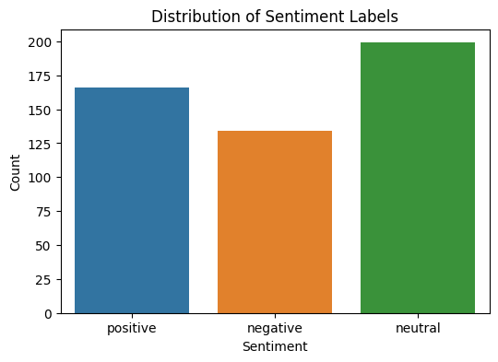
Data Exploration
Bar chart distribution
- Neutral posts are the most frequent
- Followed by positive posts
- Negative is the least

Slide 4
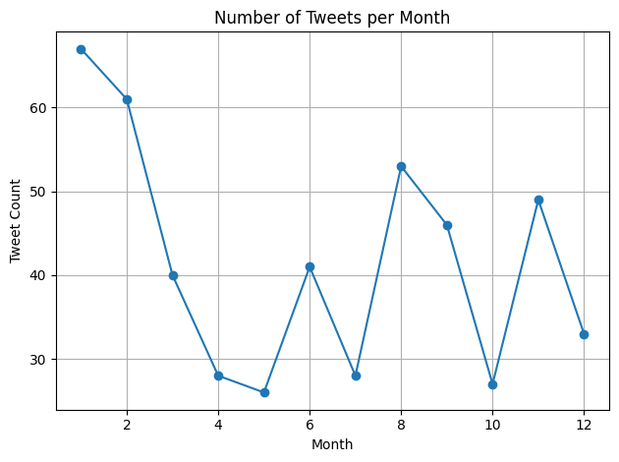
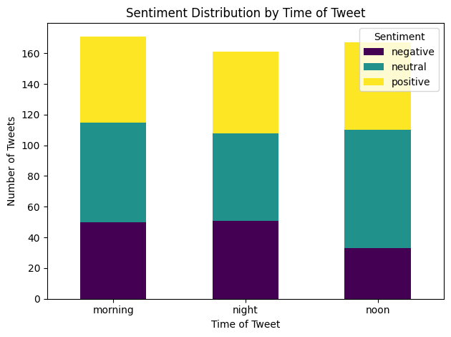
For each number of tweets during the day the bar chart
illustrates counts of categories during the day periods.
This line plot shows that we have a higher tweets account at the beginning of the year and bless during and it gets higher again during the end of the year.

Slide 5
preprocessing steps
Clean text function included removing stop words, lowercasing the text, tokenizing words and limitation all using nltks.
Feature extraction
After experimenting with multiple vectorization approaches tfidf vectorizer has the best results.

Slide 6

Overview of models tested
In the evaluation phase, several machine learning models were tested for their effectiveness in sentiment classification.
The models included:
Multinomial Naive Bayes
Logistic Regression
Linear Support Vector Classifier (LinearSVC)
Random Forest
Voting Classifiers (Hard and Soft)
GridSearchCV for tuning LinearSVC
Each model was implemented with careful consideration of preprocessing techniques and vectorization methods to ensure optimal performance in predicting sentiment.

Slide 7
Linear Support Vector Classifier (LinearSVC)
This project successfully demonstrated the capacity of Natural Language Processing (NLP) to analyze sentiments within tweet data.
The final model selected for this project was LinearSVC combined with a cleaned text dataset and TF-IDF vectorization (ngram: 1–2, min_df: 2).
The primary finding revealed that Linear Support Vector Classifier (LinearSVC) provided the most reliable classification results, achieving an accuracy of 0.74 across sentiment categories.
This choice was driven by the model ability to balance precision and recall effectively, offering consistent performance across all sentiment classes. Furthermore, its speed and robustness made it suitable for real-world deployment, ensuring scalability even as dataset sizes increase.

Slide 8
Performance metrics used
To measure the effectiveness of each model, metrics such as accuracy, precision, recall, and F1-score were employed.
These metrics provided a comprehensive view of the models' performance, especially in terms of how well they predicted the different sentiment classes. Additionally, GridSearchCV was utilized to fine-tune hyperparameters and maximize the models’ predictive capabilities.

Slide 9
Conclusions
In conclusion, the project underscored the value of applying NLP techniques for sentiment analysis in social media contexts. Through meticulous model evaluation and selection, it highlighted that preprocessing, choice of features, and iterative testing are key to enhancing accuracy. This study sets the stage for future applications, such as incorporating real-time updates and user engagement metrics to further enrich sentiment analysis capabilities.

Slide 10
THANK YOU!
Ghazal Almidana - Zaid Eltabatebi - Khadeejeh Abedrabu
Natural Language Proccessing Course

